Slide 1







Snowflake Key Concepts and Architecture
Modern Cloud Data Platform Overview

Slide 2


Snowflake Overview
Cloud-based data platform available on AWS, Azure, and Google Cloud
Combines a new SQL query engine with a cloud-native architecture
No hardware or software management required
Snowflake fully manages maintenance, upgrades, and tuning
Cannot be installed on-premises or in private clouds

Slide 3

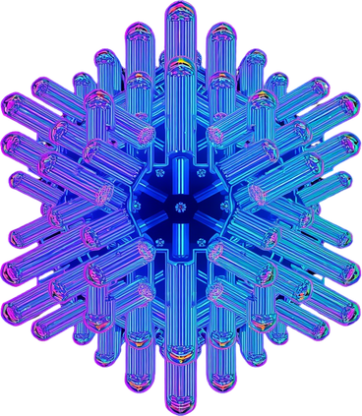

Snowflake Architecture Overview
Shared-Disk
Shared-Nothing
Hybrid
Central data repository accessible by all compute nodes
Massively parallel processing across independent clusters
Combines simplicity of shared-disk with scale of shared-nothing

Slide 4
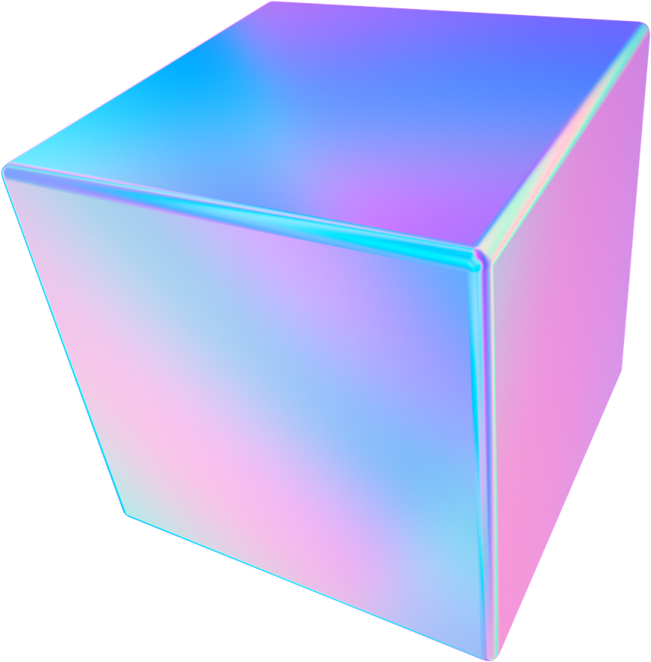
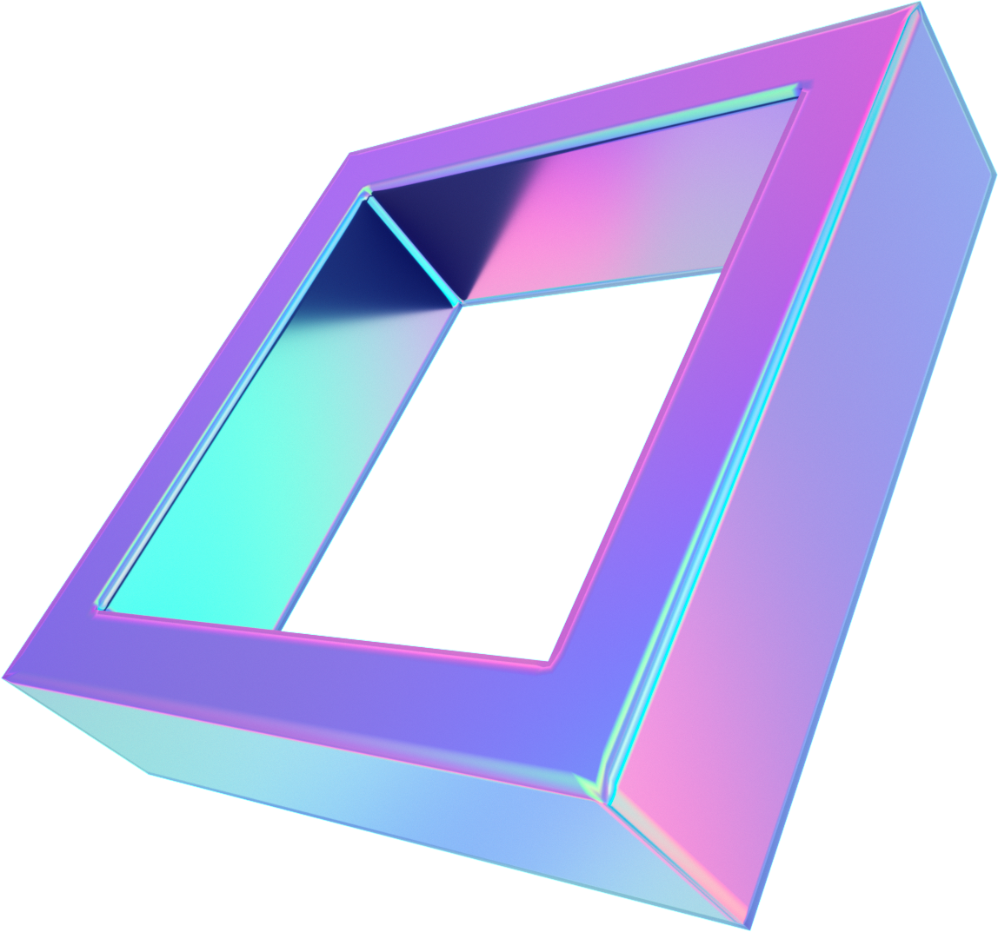
Snowflake Architecture Layers
Storage · Compute · Cloud Services

Slide 5
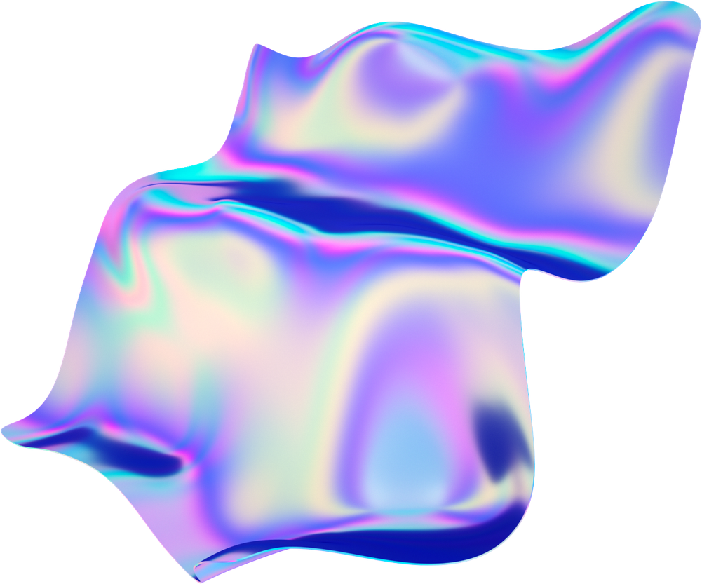
Database Storage Layer
Snowflake Tables
Iceberg Tables
Hybrid Tables
Internal storage
Compressed columnar format
Micro-partitions
Structured & semi-structured data
Snowflake-managed cloud storage
External cloud storage
Open table format
Data lake integration
Customer-managed storage
Full Snowflake SQL support
Low-latency reads
Transactional workloads
Row-based storage
Primary key support
OLTP use cases

Slide 6
Snowflake Tables Deep Dive
Data reorganized into optimized, compressed columnar format
Stored in Snowflake-managed cloud storage
Micro-partitions improve query efficiency and pruning
Supports structured, semi-structured, and unstructured data via FILE type

Slide 7


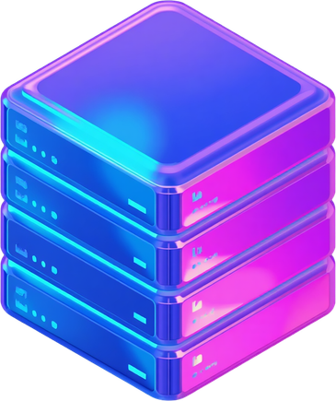
Compute Layer - Virtual Warehouses
Independent
SQL & Snowpark
Zero Sharing
Compute Clusters
Java, Python, Scala
No Performance Impact

Slide 8
Cloud Services Layer
Security
Metadata
Query & Infra
Authentication & access control
Role-based permissions
Data encryption
Regulatory compliance
SNOWFLAKE database
Information Schema
Object catalog management
Statistics tracking
Query parsing
Query optimization
Infrastructure mgmt
Cloud compute instances

Slide 9

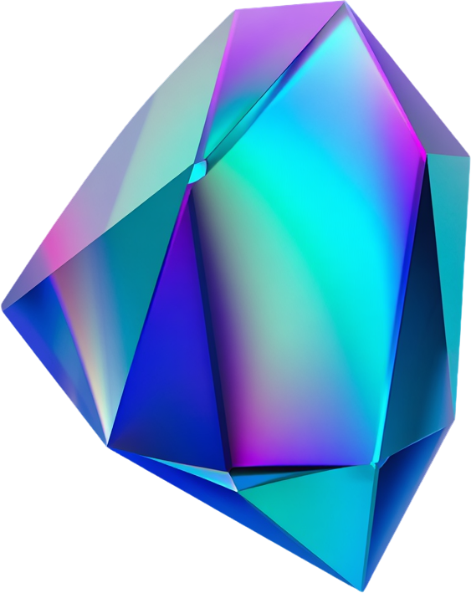

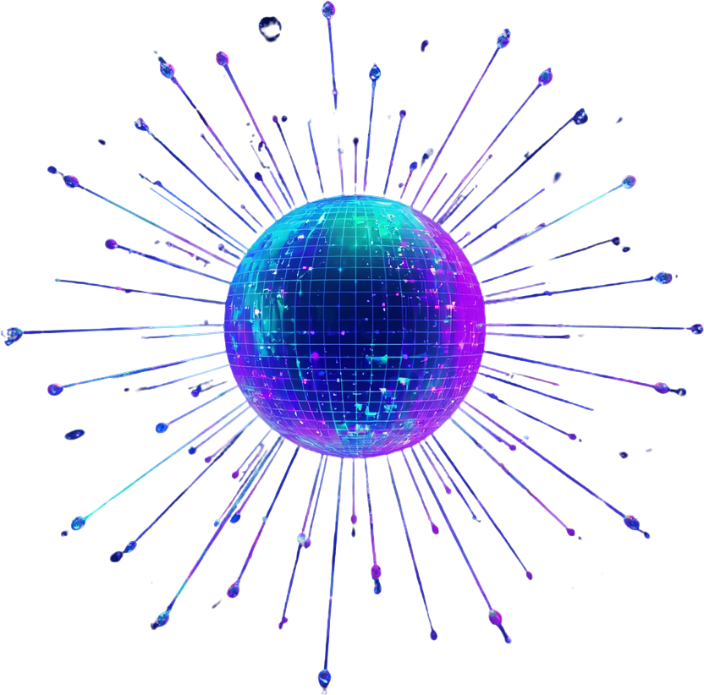
Integrated Features for Data Engineering
Transformation
Ingestion
Tools

Slide 10



Analytics Capabilities
SQL Analytics
Cortex AI
Semantic Views
Aggregate & Window Functions, CTEs for advanced query logic
LLM-powered functions for unstructured text & image data
Business concept modeling & governed metric definitions

Slide 11


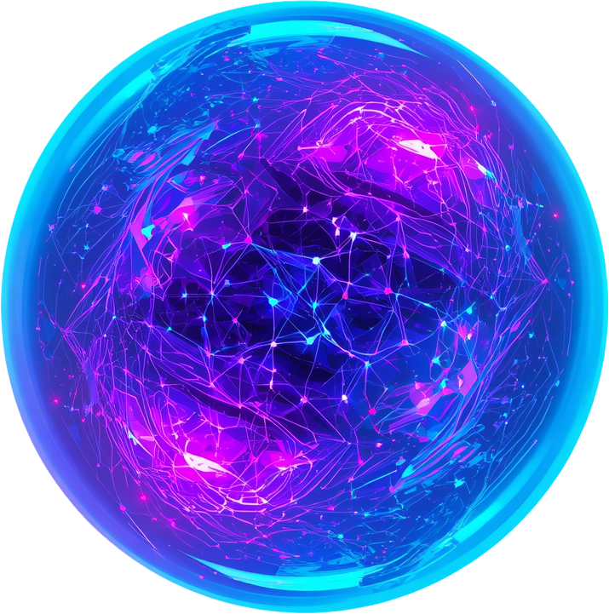
AI and Machine Learning
Snowflake Cortex
No Data Movement
Snowflake ML

Slide 12
Applications & Collaboration
Apps
Collaboration
Privacy
Streamlit
Custom web apps
Snowpark Container Services
Containerized deployment
Native App Framework
App development & sharing
Secure Data Sharing
Marketplace Listings
Cross-org data access
Governance & controls
Data Clean Rooms
Secure collaboration
Privacy-preserving analysis
No raw data exposure

Slide 13
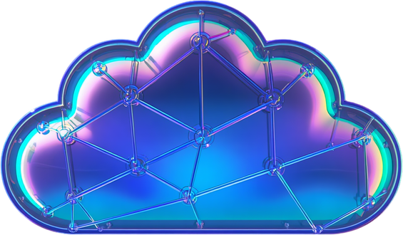


Snowgrid - Cross-Cloud Connectivity
Multi-Cloud
Governance
Resilience
Connect data ecosystems across AWS, Azure & GCP
Apply consistent security & governance policies
Enable disaster recovery & business continuity via replication

Slide 14
Connecting to Snowflake
Snowsight web UI and Snowflake CLI (command-line client)
Native APIs: Python API and REST API for programmatic access
Drivers: JDBC and ODBC for standard database connectivity
Native connectors: Apache Kafka, Apache Spark via Snowpark
Third-party tools: Informatica, ThoughtSpot, and more

Slide 15

Questions & Discussion
Thank You
Explore Snowflake: docs.snowflake.com
Snowflake Trial: app.snowflake.com
Community: community.snowflake.com

